Slide 3
Cloudify your Windows File Server
Jan Egil Ring

Slide 4
Agenda
Introduction – what is the goal?
Deployment
Monitoring
Backup
Head to head: Amazon FSx for Windows File Server
Demos
Install and configure Azure File Sync
Backup and monitoring
Fully automated installation on Server Core

Slide 5


Why move your on premises file servers to the cloud?
Reduce on premises storage footprint
Centralize data
Reduce management overhead
Save $$$
Notes:
What is the goal?
Even though it might seem so, the message to customers isn’t that the replacement for on-premises file servers is OneDrive and SharePoint Online.
Sharepoint is very useful for Office document team share collaboration scenarios.
While the trend is to move user and shared data from traditional file servers to cloud services like Sharepoint Online, in most cases the file server won`t go away. It is used for many other purposes, such as centralized application data.
-Reduce footprint on an expensive SAN
-Reduce management overhead
-Expand capacity as data grows – including backup capacity

Slide 6











Advantages of Azure File Sync
Cloud Tiering
Cloud Access
Azure Backup
Multi-site Sync
File Share
Cloud Backup
Rapid File Server DR
SMB
NFS
Users
Work Folders
Applications
File Sync Server 1 Oslo
File Sync Server 2 Copenhagen
File Sync Server 3 Stockholm

Slide 7
Deploy Azure File Sync in a few easy steps
4
3
2
1
Sync Group
Azure File Share
Cloud Endpoint
Server Endpoint 1
OSL
X:\mktg
CPH
X:\mktg
Server Endpoint 2
Sync Agent
Sync Agent

Slide 8
Step 1 - Create Azure Storage Account and file share
Azure File Share

Slide 9
Step 2 – Create Sync Group and connect it to Azure File Share
Sync Group
Azure File Share
Cloud Endpoint

Slide 10
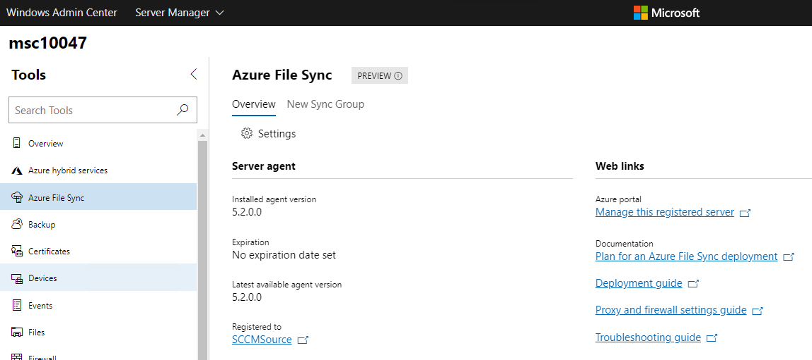
Windows Admin Center integration
Windows Admin Center 1904
Adds support for Azure File Sync and several other Azure hybrid services
Notes:
Consolidating all of Windows Admin Center’s optional Azure services into a centralized hub, the Azure hybrid services tool lets you easily discover and leverage the value that Azure can bring to your on-premises or hybrid environment.
https://techcommunity.microsoft.com/t5/Windows-Admin-Center-Blog/Windows-Admin-Center-1904-GA-update-is-now-available/ba-p/443407

Slide 11
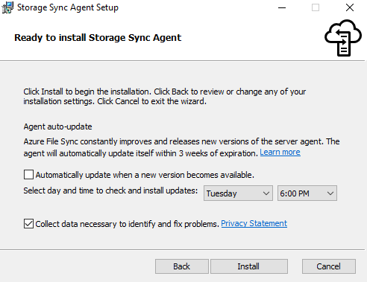
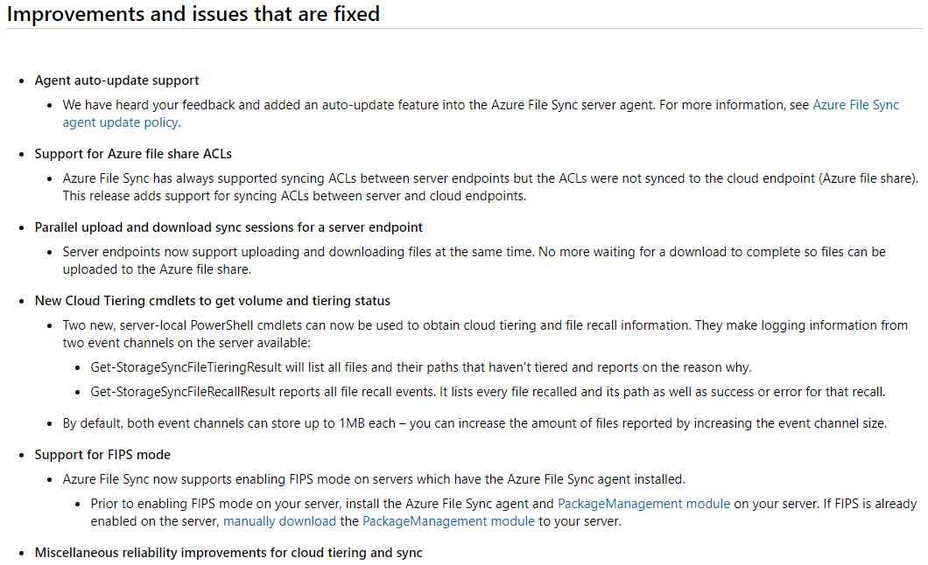
Azure File Sync Agent Version 6
Released April 22, 2019 (KB4489736)

Slide 12
Demo
Install and configure Azure File Sync
Notes:
Prepare data disk and install agent on BranchFS1
Create File Sync instance in Azure Portal
Create Storage Account

Slide 13


Get Started With Azure File Sync - summary
Azure File Sync can help you move your data into cloud while keeping your frequently accessed data near you
Create Sync Group
Register Server
Create server endpoint
Windows File Server
On prem and Cloud Access
Azure Storage Sync Service
Existing End Users Access
Azure Files share
No change in Application config
In a nutshell
Prepare Server
Connect to cloud
Setup Prerequisites
Access from anywhere

Slide 14
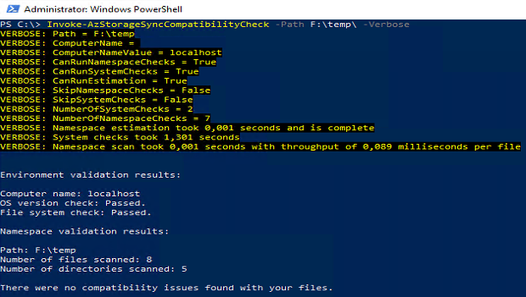
Tip: Evaluation tool
Checks for potential issues
File system and dataset
Unsupported characters
Unsupported OS version
And more
Install-Module -Name Az.StorageSync
Invoke-AzStorageSyncCompatibilityCheck -Path D:\
https://docs.microsoft.com/en-us/azure/storage/files/storage-sync-files-planning
Notes:
Before deploying Azure File Sync, you should evaluate whether it is compatible with your system using the Azure File Sync evaluation tool. This tool is an Azure PowerShell cmdlet that checks for potential issues with your file system and dataset, such as unsupported characters or an unsupported OS version. Note that its checks cover most but not all of the features mentioned below; we recommend you read through the rest of this section carefully to ensure your deployment goes smoothly.

Slide 15
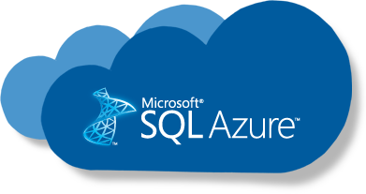
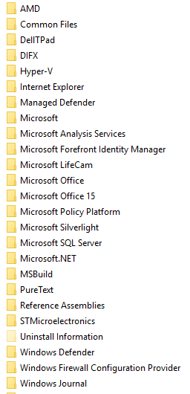
Azure File Sync
West US
File Share
HQ Seattle

Slide 16
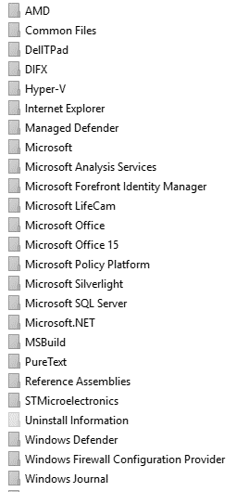
Azure File Sync
West US
Cloud Tiering
File Share
HQ Seattle

Slide 17

Azure File Sync
West US
Cloud Tiering
File Share
Multi-site sync
Rapid file server DR
SMB
NFS
Users
Work Folders
Applications
Branch Office New York
HQ Seattle

Slide 18


Azure File Sync
PaaS
SMB
REST
West US
Azure Backup Vault
IaaS
Cloud Tiering
File Share
Multi-site sync
Rapid file server DR
Direct cloud access
SMB
NFS
Users
Work Folders
Applications
Integrated cloud backup
Branch Office New York
HQ Seattle

Slide 19

Azure File Sync
Cloud Tiering
cold file
Metadata
Data stream
File
Cloud Tiering enabled by a file system filter driver
Builds a “heatmap” based on:
last-accessed-time
frequency of access
Date tiering

Slide 20




Azure File Sync
Azure File Share
Cloud Tiering
cold file
Metadata
Data stream
File
A cold file’s content is displaced from the server cache
The file remains visible in the namespace
A reparse point links to the file in the cloud
Notes:
End user experience is similar to «files on demand» in OneDrive

Slide 21


Azure File Sync
Azure File Share
Cloud Tiering
partial file recall
Metadata
Data stream
File

Slide 22



Azure File Sync
File attributes
(O) offline
(P) sparse (L) reparse point “recall on acc.”
Cloud Tiering
virus scan
Metadata
Data stream
local backup
File
Multi-site sync
AV scans meta data & finds secure offline attribute
Does not access file content, thus avoiding recall
Notes:
Because antivirus works by scanning files for known malicious code, an antivirus product might cause the recall of tiered files.
In versions 4.0 and above of the Azure File Sync agent, tiered files have the secure Windows attribute FILE_ATTRIBUTE_RECALL_ON_DATA_ACCESS set. We recommend consulting with your software vendor to learn how to configure their solution to skip reading files with this attribute set (many do it automatically).
Microsoft's in-house antivirus solutions, Windows Defender and System Center Endpoint Protection (SCEP), both automatically skip reading files that have this attribute set. We have tested them and identified one minor issue: when you add a server to an existing sync group, files smaller than 800 bytes are recalled (downloaded) on the new server. These files will remain on the new server and will not be tiered since they do not meet the tiering size requirement (>64kb).
Source: https://docs.microsoft.com/en-us/azure/storage/files/storage-sync-files-planning

Slide 23

Azure File Sync
Multi-site sync
Azure File Sync
Azure File Share
process
2
Sync metadata sync protocol
3
File transfer REST protocol
1
Detects file change (USN journal)
HQ Seattle

Slide 24



Azure File Sync
Encryption at rest Tenant isolation Sync metadata only
Encryption at rest
Multi-site sync
Azure File Sync
Azure File Share
end-to-end encryption
2
Sync metadata sync protocol
3
File transfer REST protocol
Encryption in transit (SSL)
Encryption in transit (SSL)
1
Detects file change (USN journal)
Encryption at rest (Bitlocker)
HQ Seattle

Slide 25
Monitoring
Portal
Azure Monitor
Event logs and performance counters on the servers
Coming: E-mail alerts and logging
https://docs.microsoft.com/en-us/azure/storage/files/storage-sync-files-monitoring (article published January 2019)
Notes:
In the Azure portal, you can view registered server health, server endpoint health (sync health), and metrics.
Use Azure Monitor to monitor sync, cloud tiering, and server connectivity. Metrics for Azure File Sync are enabled by default and are sent to Azure Monitor every 15 minutes.
Use the Azure File Sync performance counters on the server to monitor sync activity.

Slide 26
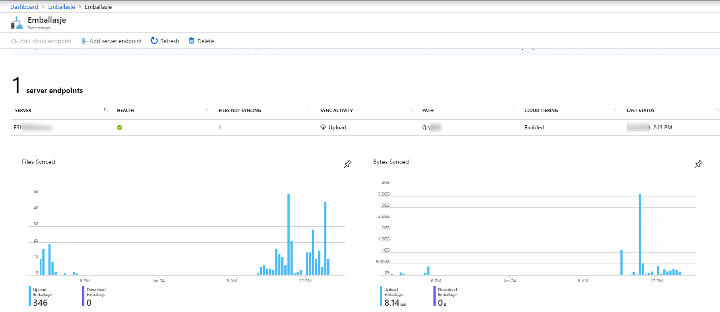
Azure File Sync - monitoring
Azure Portal
https://portal.azure.com
Notes:
Added in January 2019

Slide 27
Demo
Monitoring Azure File Sync

Slide 28
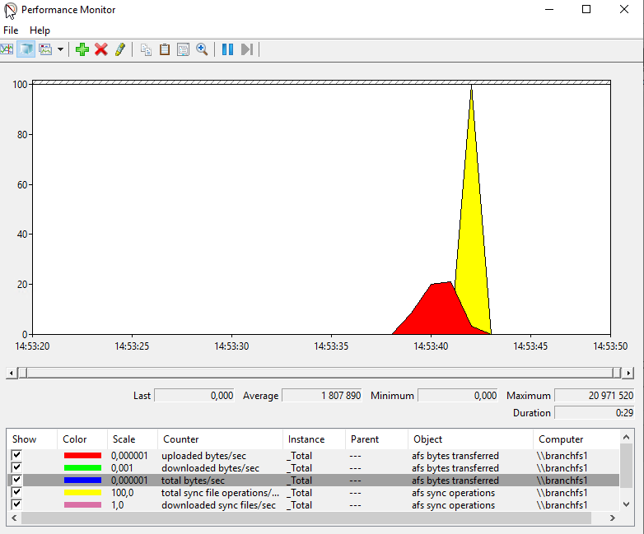
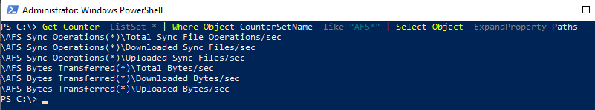
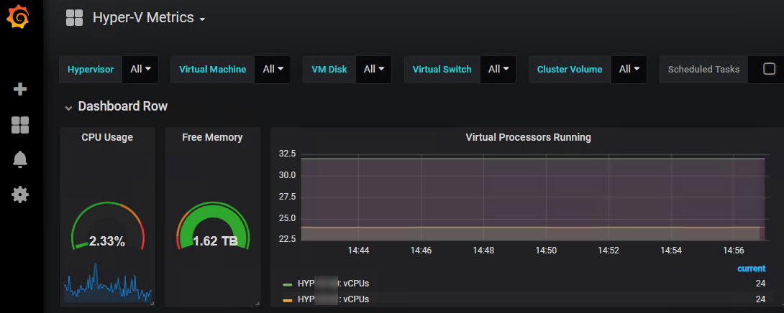
Azure File Sync - monitoring
Performance Counters
Notes:
Grafana and InfluxDB

Slide 29
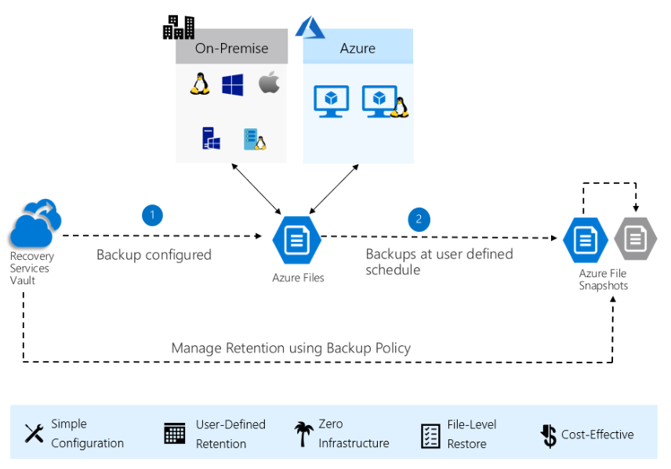
Backup
Azure Backup
Azure Backup agent (MARS)
System Center DPM
Azure Backup Server
Azure IaaS VM Backup
Azure File Shares (preview)
https://docs.microsoft.com/en-us/azure/backup/backup-introduction-to-azure-backup
https://docs.microsoft.com/en-us/azure/backup/backup-azure-files
https://azure.microsoft.com/en-us/blog/introducing-backup-for-azure-file-shares/
Notes:
A Recovery Services vault is an online storage entity in Azure used to hold data such as backup copies, recovery points, and backup policies.
You can back up at scale by selecting multiple file shares in a storage account and apply a common policy over them.
Since Azure Backup utilizes file share snapshots, you can restore just the files you need instantly even from large file shares.
Azure Backup lets you browse the restore points of your file shares directly in the Azure portal so that you can pick and restore only the necessary files and folders.
Tentative timeline is H1 CY19

Slide 30
Demo
Backing up Azure File Shares

Slide 31
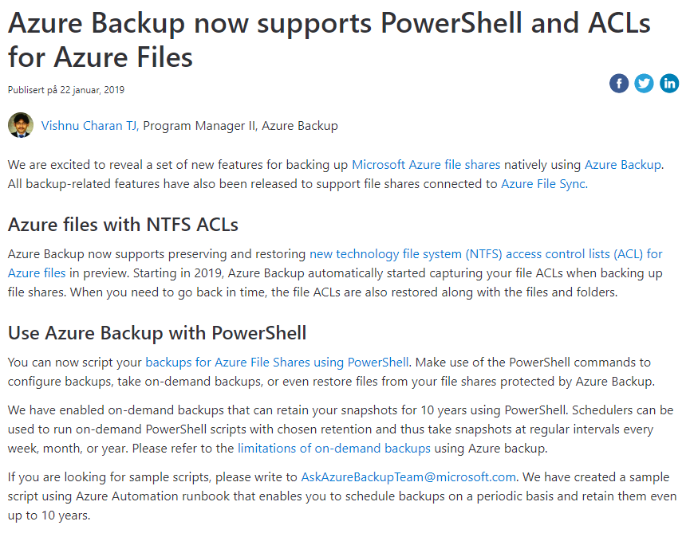
https://azure.microsoft.com/nb-no/blog/azure-backup-now-supports-powershell-and-acls-for-azure-files/

Slide 32
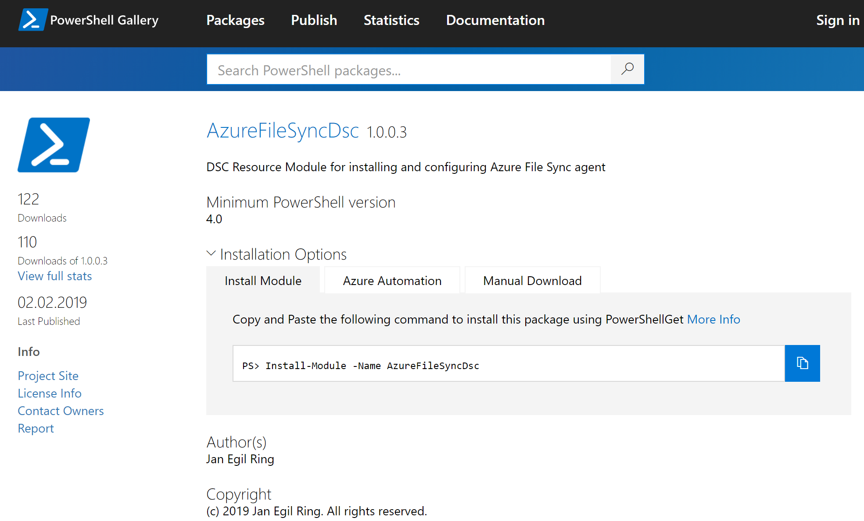
Azure File Sync – automated provisioning
https://github.com/janegilring/AzureFileSyncDsc
Notes:
Works on 2012 R2 and later – including 2019

Slide 33
Demo
Automated provisioning

Slide 34
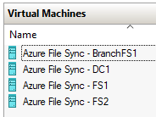
Azure File Sync – lab environment
Lability – test lab deployment and configuration PowerShell module
Easily deploy (and re-deploy) full lab environments on Hyper-V in Windows 10 fully automated
Leverages PowerShell Desired State Configuration under-the-hood
Detailed introduction:
http://www.powershell.no/hyper-v,/powershell/dsc/2017/07/19/lability.html
Configuration script for Azure File Sync lab used in this presentiation is available in GitHub:
https://github.com/janegilring/Presentations\2019 Microsoft Ignite - The Tour - Stockholm
Links will be posted on Twitter after the session – follow @JanEgilRing
Notes:
Grab a coffee and your lab will be deployed when you get back
If you don`t have access to a Windows 10 machine with sufficient resources, one option is to provision a Windows 10 VM in Azure. It can be configured to use Auto-shutdown in order to minimize costs.

Slide 35
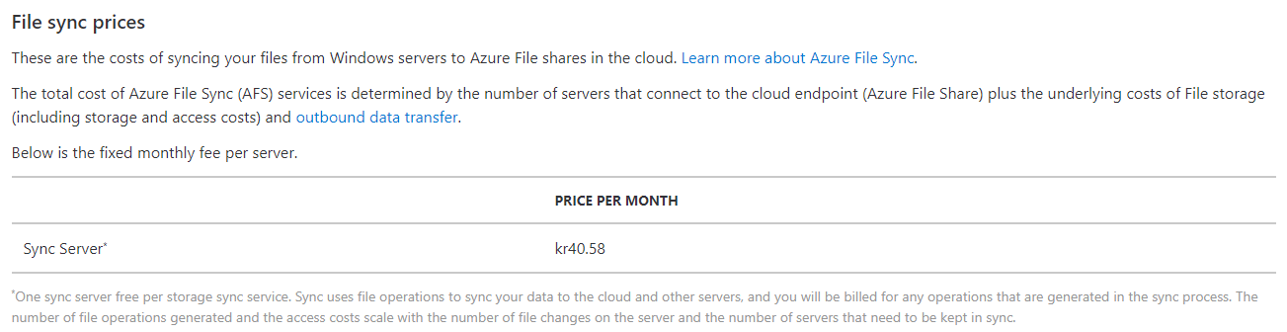
Azure File Sync - Cost
Pricing calculator and more info:
https://azure.microsoft.com/en-us/pricing/details/storage/files/
Notes:
File Sync itself has a cost, you're just paying for the space you're using in your storage account. Data transfer in to Azure is free, so the files syncing to Azure would be free. Files getting pulled back down to on-prem would fall under their Outbound Data Transfer pricing.
Example:
The total size of a file server cluster a customer are considering to leverage Azure File Sync for is about 11 TB - the total cost would be roughly 9 000 NOK (1080 USD) per month.
Will save a lot of space on existing SAN by leveraging cloud tiering
Backup costs moved from on-prem hardware to cloud service – the file server cluster had a large foot print on the backup system
Azure File Sync replaces DFS-Replication
Disaster recovery and restore times drastically reduced

Slide 36
Head to head
Amazon FSx | Azure File Sync
Wrapper around Windows Server | Native SMB built for cloud scale
Constrained to features available in Windows Server | Cloud-native storage platform
AD integration | AD and Azure AD integration
Premium (SSD) only | Standard (HDD) and Premium
Amazon FSx for Windows File Server
https://aws.amazon.com/fsx/windows
Notes:
Disclaimer: The presenter does not have any hands-on experience with Amazon FSx – this is just basic comparisons based on information available in the product documentation.
Microsoft is a large contributor to the SMB protocol.
Use HDD/cheaper storage for cool data.
Not verified, but FSx seems to be supported for mounting shares only inside Windows and Linux EC2 instances – not on-premises (based on the documentation available Jan 2019)
Differentiator:
Due to it`s local cache Azure File Sync might seems more appropriate for scenarios where large files such as CAD drawings is used by end users.

Slide 37









Azure File Sync
file sync
file sync
Branch
Centralize file services in Azure storage
file sync
Cache in multiple locations for fast, local performance
Utilize cloud-based backup and fast DR
Branch
HQ Cluster

Slide 38
Key takeaways
Take advantage of cloud storage by not compromising on prem experience.
1
Reclaim your on premises storage space for other purpose
2
3
Easy to get started
Provision Sync Service and storage account in Azure
Install and configure agent

Slide 39
Resources
Azure File Sync documentation
https://docs.microsoft.com/en-us/azure/storage/files/storage-files-planning
https://docs.microsoft.com/en-us/azure/storage/files/storage-sync-files-planning
https://docs.microsoft.com/en-us/azure/storage/files/storage-sync-files-deployment-guide
Lability – build an automated Azure File Sync lab environment
http://www.powershell.no/hyper-v,/powershell/dsc/2017/07/19/lability.html
https://github.com/janegilring/PSCommunity/tree/master/Lability

Slide 40
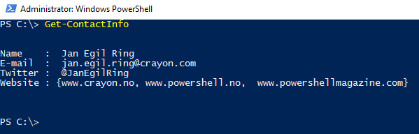
Contact info
Thank you!

